Slide 1
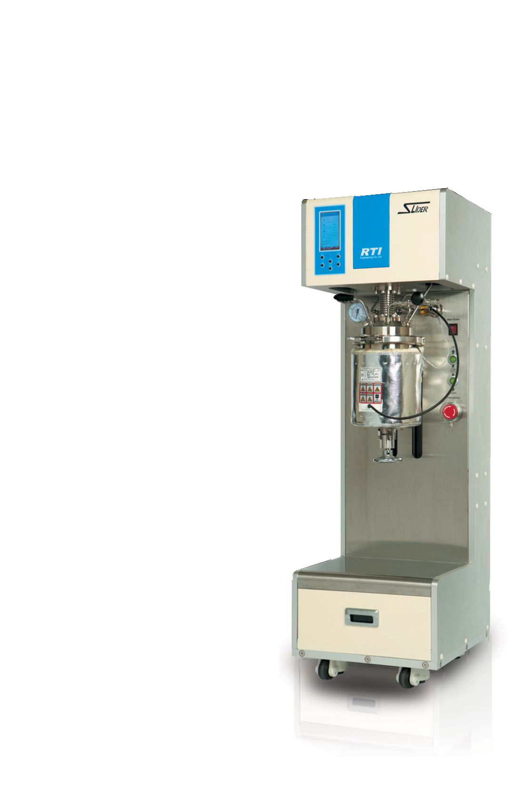









ORDERING INFORMATION
Model 1
Options
SD : Standard
HP : High Pressure
HT : High Temperature
HTP : High Pressure & Temperature
01 : Liquid feeding system
02 : Gas feeding system
03 : Vapor recovery system
04 : Vacuum unit
05 : Pressure control unit (Manual)
06 : Pressure control unit (Auto)
07 : Spare kit (1 year)
08 : Tool kit
09 : Jacket & Cooling Bath
10 : Jacket & Heating Bath
11 : External jacket only
Model 2
Temperature
Blank : Standard
C : Corrosive Condition
S1 : -20~20℃[-4~68℉]
S2 : 0 ~ 100℃ [212℉]
H1 : 0 ~ 200℃ [392℉]
H2 : 0 ~ 300℃ [572℉]
Compact Design !
Easy Operation !
Multi Application !
Good Price !
Vessel Capacity
1, 2, 3, 4, 5 [Litres]
Pressure
Vessel material
S1 : 0 ~ 5 bar [72.5 psig]
S2 : 0 ~ 10 bar [147 psig]
H1 : 10 ~ 50 bar [725 psig]
H2 : 10 ~ 100 bar [1,470 psig]
H3 : 50 ~ 150 bar [2,205 psig]
H4 : 100 ~ 170 bar [2,500 psig]
1 : Standard [316SS]
2 : 304SS
3 : 310SS
4 : Inconel
5 : Hastelloy-C276
6 : Others [need to confirm]
1 ~ 5 Liters
max. 2,500 psig (170 bar) max. 300°C (572°F)
max. 30,000 cps.
max. 1,800 rpm
■ Headquarters
(04144) #1402, Poonglim VIP TEL, 127,
Mapo-daero, Mapo-gu, Seoul, Korea
(Tel) +82-2-702-7201
(Fax) +82-2-704-7202
E-mail : sales@seintns.com
■ Gimpo Factory
(10048) Na-dong 127,
117, Hwanggeum-ro, Yangchon-eup, Gimpo-si, Gyeonggi-do, Korea
(Fax) +82-31-999-7202

Slide 2
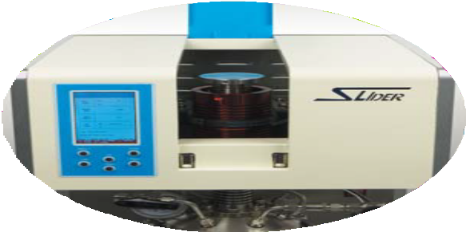


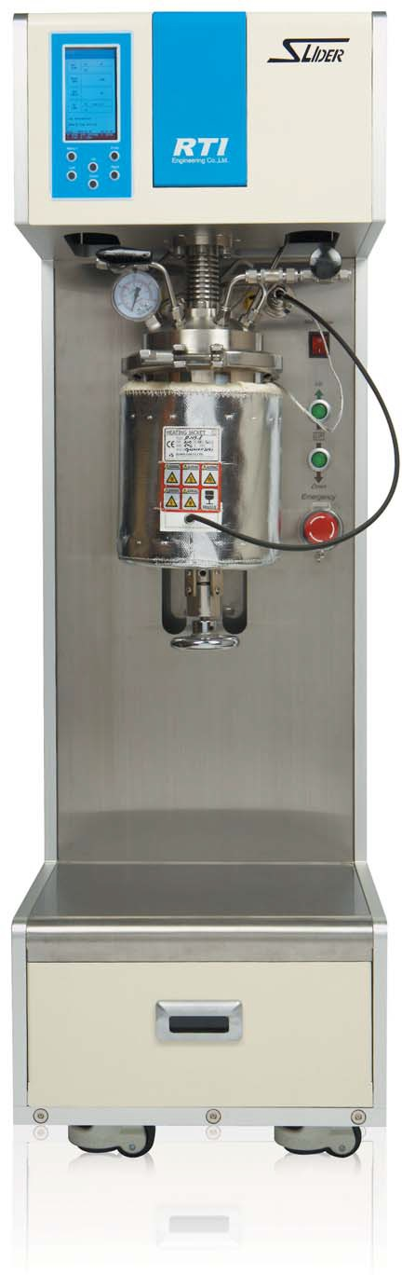
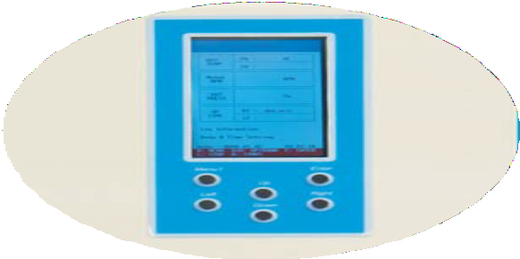

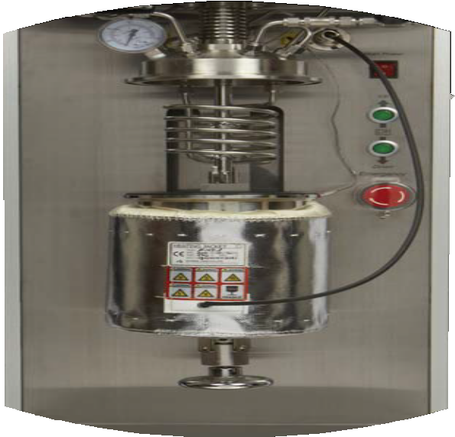
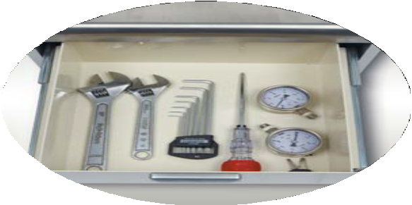
An Inspired Future Shaped through Challenge & Change
COMPACT & SIMPLE DESIGN !
깔끔하고 심플한 디자인
쉬운 이동 설치
좁은 설치 공간
EASY OPERATION & MAINTENANCE !
간편하고 손쉬운 작동법
손쉬운 세척 및 유지보수 용이
Spare, 부품, 공구관리함 설치
MATERIAL SPECIFICATION
Model | SD | HP, HT, HTP | SDC, HPC, HTC, HTPC
Vessel | 316SS | 310SS, Inconel | Hastelloy-C276
Jacket (Option) | 304SS | 304SS | Hastelloy-C276
Shaft / Impeller | 316SS | 316SS | Hastelloy-C276
Gasket | PTFE | 316SS | Hastelloy-C276, Teflon
Inner Cooling coil | 316SS | 310SS, Inconel | Hastelloy-C276
Thermo-well | 316SS | 310SS, Inconel | Hastelloy-C276
Dip-tube | 316SS | 310SS, Inconel | Hastelloy-C276
O-ring | Viton | Kalrez | Kalrez
Bottom Valve | 316SS | 316SS | Hastelloy-C276
Bottom Valve Seal | Kalrez | Kalrez | Kalrez
Frame | 304SS, Aluminium, SS41 | 304SS, Aluminium | 304SS, Aluminium
Valve & Fittings | 316SS | 316SS | Hastelloy-C276
MULTI-PURPOSE & APPLICATION !
다양한 용도의 실험에 사용
[Barch reaction, CSTR, Synthesis process,
Polumeryzation, Catalyst reaction etc.]
화학, 체약, 식품분야 등 다양한 분야에 적용 가능
HIGH PERFORMANCE & GOOD PRICE !
고온, 고압 운전 적용 가능
고점도, 고속운전 가능
빼어난 내구성, 다양한 Option 적용
성능대비 저렴한 가격!
PRESSURE & TEMPERATURE, VISCOSITY, ELECTRIC
Model | SD | HP, HT, HTP | SDC, HPC, HTC, HTPC
Max. Pressure bar (psig) | 10 (147) | 170 (2,500) | 170 (2,500)
Max. Temperature °C(°F) | -20 ~ 100 °C (482) | 300 °C (572) | 300 °C (572)
Viscosity (cps.) # 100 °C (212°F) | Max. 30,000
Electric specification | 110/220VAC, 1ph, 50/60Hz, 15A
MAIN COMPONENTS
Model | SD | HP, HT, HTP | SDC, HPC, HTC, HTPC
Standard | Vessel, Controller, Stirring unit(Motor unit+Magnetic Drive+Shaft & Impeller), Bottom valve, Pressure Gauge, Pressure Relief valve, Temperature sensor(2), Pressure sensor,Heater, Lifting unit, Cooling coil, Thermo-well, Dip-tube, Ball velve(1), Needle valve(1), Fittings, Frame
Options | Liquid & Gas Feeding system, Vapor recovery system, Vacuum unit, Pressure Control Unit, Spare kits, Tool kits. Cooling bath, Heating bath, External Jacket
Lab-scale Batch Reactor System
SLIDER
SEIN TNS CO.,LTD.
www.seintns.com

